Slide 1


Payments to governments data and resourceprojects.org
Notes:
Introduction
From the governance team at NRGI based in London
Shared the importance of managing the revenues you receive from extractives in Ghana – this session will go into how you can add data to stories to communicate to your audience how much the government receives from its oil and gas and mining to put pressure on government entities to manage these revenues well
Aim is to make your life easier – add data in a way that can instantly add a hook, important and new piece of news to your stories
Presentation on New revenue data source, how this new data source can add to stories in Ghana and how NRGI can support journalists in adding this data to their stories

Slide 2
Overview
Introduce payments to governments data
Outline NRGI use cases for payments to governments data and reosurceprojects.org
Demonstrate features of resourceprojects.org
Outline planned new features for resourceprojects.org
Notes:
Overview of Mandatory disclosure laws and payments to governments data
What companies disclose in Ghana – both oil and gas and mining
How this data can be relevant to ongoing stories in Ghana
How NRGI has supported journalists in using this data

Slide 3
Mandatory disclosure laws - Overview
US: Dodd Frank 1504
Canada ESTMA
G8 commitment June 2013
Switzerland (draft law this week) / Ukraine…
Passed December 2013; in force January 2014
Norwegian Regulation on Country By Country Reporting
EU Accounting and Transparency Directives
Passed mid-2013; 28 EU countries had to transpose (implement) by mid-2015
Payment disclosure by US-listed oil, gas, and mining companies at project level
Consistent with 1504; also includes large private companies and logging companies / Approx. 150 companies
Extractive Sector Transparency Measures Act (private and listed companies)
Legislation Dec 2014; in force June 2015
Consistent with 1504/EU Directives
Goes further: all subsidiaries, revenue, cost, investments
Australia – Labour Party commitment. General election?
BRICS/MINT and other major economies?
Passed June 2010; initial 2012 SEC rules vacated, 2016 rules disapproved
Approximately 400 reports
Going global…?
New rules due by Feb 2018; also repeal Bill in Congress
Notes:
– Come about due to laws in EU Canada and Norway that require companies to disclose the payments they make to governments for the extraction of oil and gas and minerals
- They are required to disclose any payment over 100,000
They have to report which specific government entity has received the revenue
Subnational entities – such as district assemblies
SOEs GNPC
They must also disclose at project-level
Must disclose payment type – i.e. royalty or dividend
Have to disclose within 150 days of end of financial year – makes this very timely. All for 2017 compared to 2015 for GEITI
Key features
Payment types:
(a) production entitlements;
(b) taxes levied on the income, production or profits of companies, excluding taxes levied on consumption such as value added taxes, personal income taxes or sales taxes;
(c) royalties;
(d) dividends;
(e) signature, discovery and production bonuses;
(f) licence fees, rental fees, entry fees and other considerations for licences and /or concessions; and
(g) payments for infrastructure improvements.

Slide 4
What is in the data?
Summary of Mandatory Disclosure laws
What companies must disclose? | Oil, gas or mining companies incorporated or listed on a regulated stock exchange in Canada, Norway or any EU Member State.
What are they required to disclose? | Payments made to governments, including state owned enterprises, in relation to extractive activities. Payments should be attributed to projects where applicable.
What types of payments must they disclose? | 1. Production entitlements 2. Taxes 3. Royalties 4. Dividends | 5. Signature, discovery and production bonuses 6. Licence Fees 7. Payments for infrastructure improvements
What is the payment threshold? | Single, or series of, payments that amount to EUR100,000 in the EU/EEA or CAD100,000 in Canada.
When do they have to disclose? | Companies have 150 days after the end of their financial year to file their Payments to Governments Report.
Notes:
Company disclosure – this is the company statement – can be used in conversation in government
Timely, important to having story relevant to audience – GEITI most recent report from 2015 – hard to gain attention of audience as much
Payment types – Every company must use same definition – and we will look at what times of payments we should expect

Slide 5
Uses For Payments To Governments Data Within NRGI

Slide 6
NRGI Priority Country Payment To Government Data: MENA

Slide 7
NRGI Priority Country Payment To Government Data: Anglophone Africa

Slide 8
NRGI Priority Country Payment To Government Data: Francophone Africa

Slide 9
NRGI Priority Country Payment To Government Data: Latin America

Slide 10
How can this data be used in NRGI country programs
Capacity Development
Fiscal Regime analysis/ Revenue Management
Project-level reporting
State owned Enterprise
Company engagement

Slide 11


Capacity Development
Engage journalists, Civil society and other oversight actors on using this data as an accountability tool in country
Examples from NRGI Country:
Civil Society:
CSO convening on Oil and Gas payments in Nigeria
Resourcebenefits.ng
BudgIT
Media engagement:
Ghana Mass Media training
Guinea - Media training
Story with Premium times on ExxonMobil lack of disclosures

Slide 12

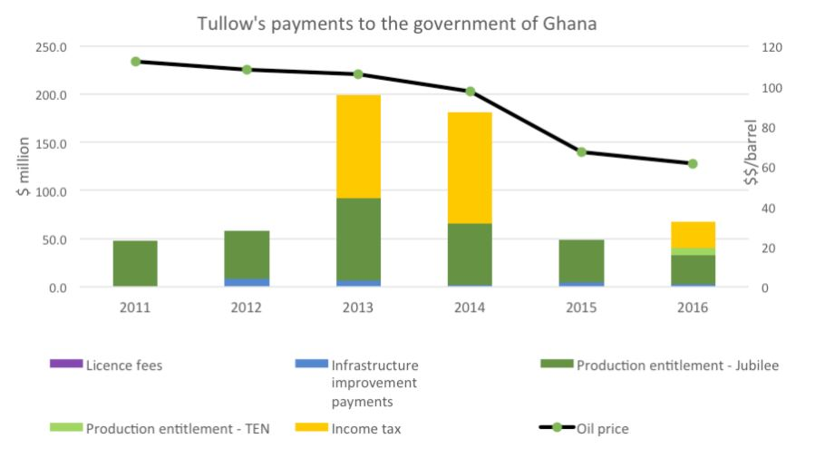
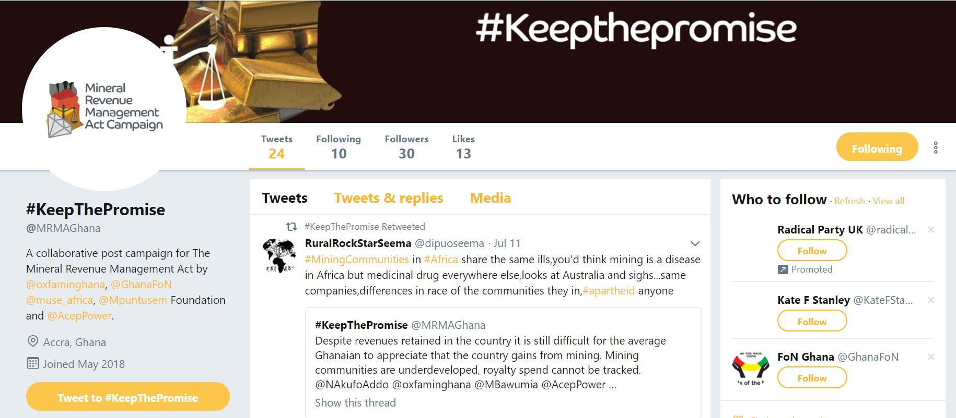
Fiscal Regime analysis/ Revenue Management
Provide analysis/ training on fiscal regime monitoring and revenue management issues
Examples from NRGI Country:
Engagement with Oxfam Ghana MRMA campaign
Ghana Fiscal regimes analysis (Tullow)
Tanzania CSO’s training
Francophone hub training

Slide 13

Project-level reporting
Help EITI countries develop their own project-level reporting practices
Demonstrate the feasibility and practicalities of project-level reporting
Engage with Government on using this company level reporting (SAI engagement; Ministry of Lands)
Examples from NRGI Country:
Presentations given to Ghana and Nigeria EITI’s on payments to governments data
In discussion to provide presentation to Zambia EITI on what data is already available to implement project-level reporting
Supporting PLSI engage with the SAI in Nigeria
Potential technical engagement with Ghana Ministry of lands interest

Slide 14
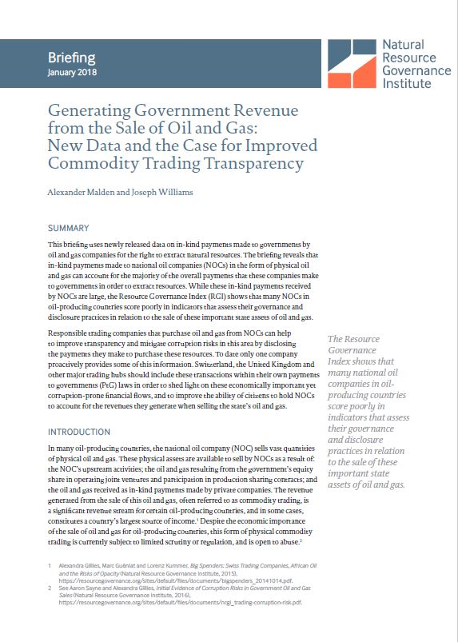
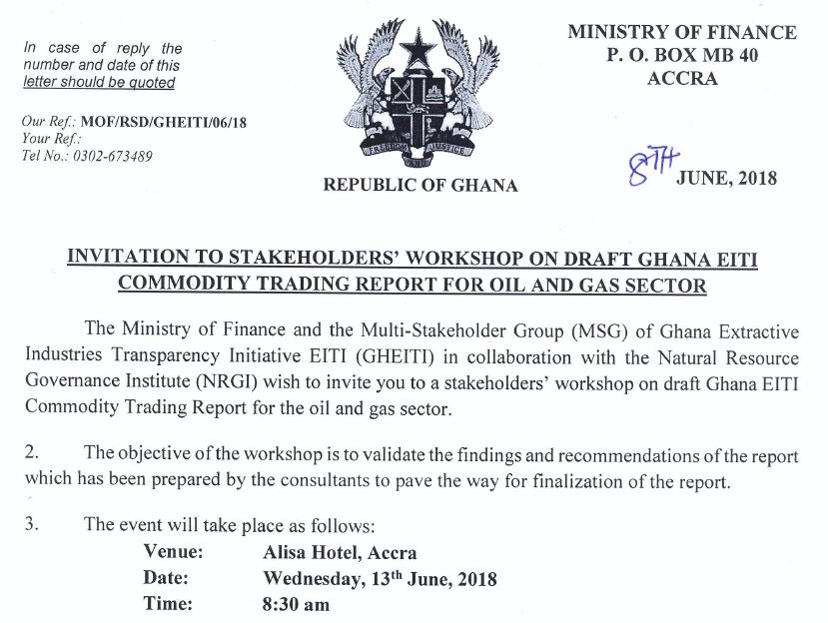
State owned Enterprise
Provide data /analysis on SOE challenges and importance of SOE’s:
Importance of SOE as recipient government entity
Proliferation of in-kind payments
Examples from NRGI:
‘Generating Government Revenue from the Sale of Oil and Gas: New Data and the Case for Improved Commodity Trading Transparency’ briefing
Ghana EITI Commodity Trading stakeholder workshop
Notes:
The major IOC;s operating on Jubilee, TEN and more recently Offshore Cape three points disclose there payments
Kosmos and Tullow both disclose proportionally for their equity share interest in Ten and Jubilee respectively
Unlike for the mining industry, there is already good revenue data coming from PIAC – this can be used to analyze and reconcile disclosures by the government

Slide 15
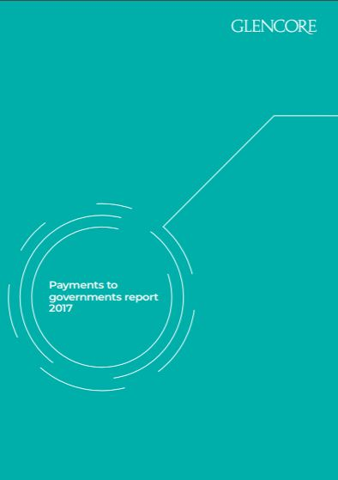

Company engagement
Dialogue with companies on their reporting practices under these laws As a starting point to engaging on global and country level issues.
We see these reports as offering useful opportunities to enhance private sector engagement at the country level.
Examples from NRGI:
We have interacted with the following companies and industry forums on reporting practices in NRGI priority companies:
Chevron (including on payments in Nigeria)
ENI (including on payments in Nigeria)
Glencore (including on payments in DRC)
Kosmos (including on payments in Ghana)
Shell (including on payments in Nigeria)
Other global- level engagements include:
The B-Team (on tax principles)
Canada’s two largest mining associations (MAC and PDAC)
Rio Tinto; Anglo American; BP; BHP Billiton
Notes:
The major IOC;s operating on Jubilee, TEN and more recently Offshore Cape three points disclose there payments
Kosmos and Tullow both disclose proportionally for their equity share interest in Ten and Jubilee respectively
Unlike for the mining industry, there is already good revenue data coming from PIAC – this can be used to analyze and reconcile disclosures by the government

Slide 16
How can NRGI staff use this data: Resourceprojects.org tool

Slide 17
Planned New Features For Resourceprojects.org/ Feedback

Slide 18
Conclusion
Payments to governments data can add an important information source to current extractives stories in Ghana
Timeliness: Reports out much quicker than EITI
TO BE COMPLETED

